Slide 1
Presented by
JOY PAL - 201002418
Md Aminul Islam - 183002137

Slide 2
D C
CALCULATOR
Using Assembly Language

Slide 3
TABLE OF CONTENTS
01
02
03
Introduction
Implementation
Output

Slide 4
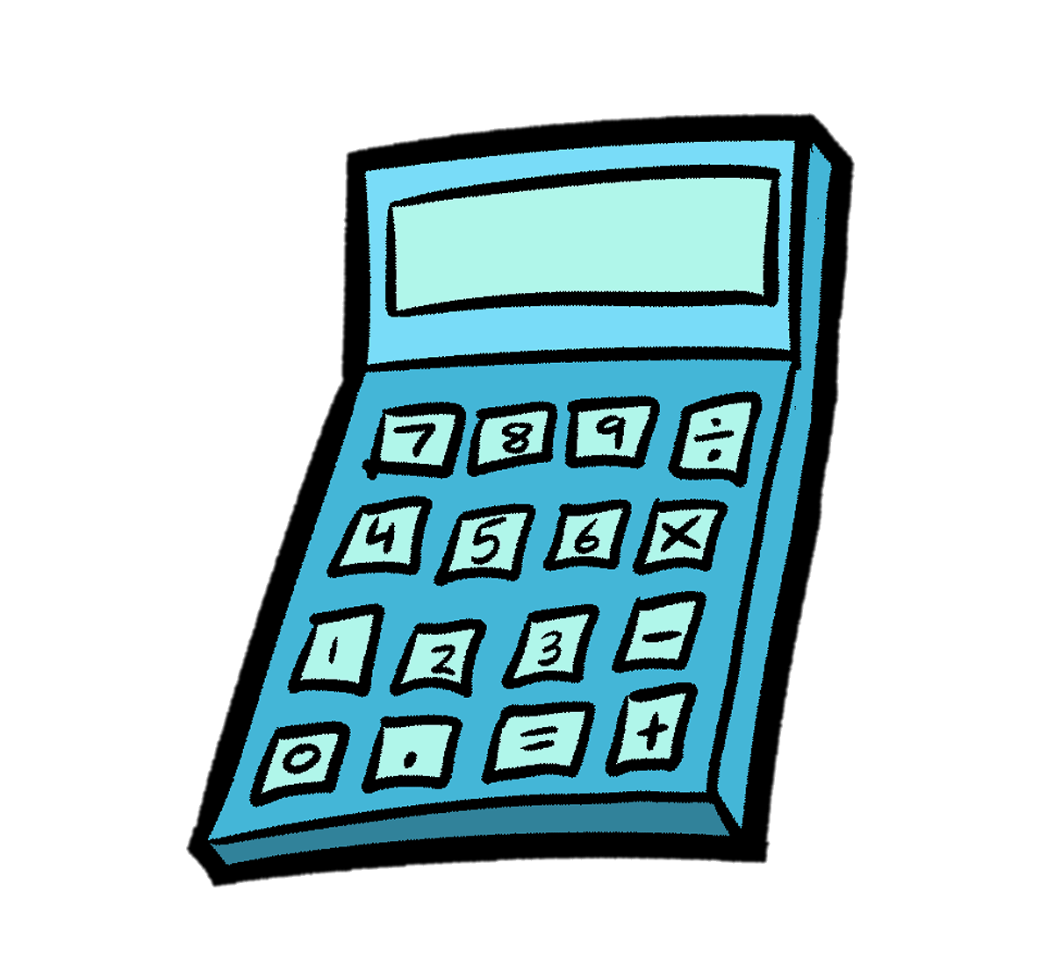
Calculator
Using Assembly Language
Calculators were created in order to give people a simple, fast, and error free method of doing these calculations. The program is designed to act like a “16–bit Decimal Calculator” with the usual standard functions (addition, subtraction, multiplication, division, modulo, and power).

Slide 5
Objectives
To learn instructions to syntax and structure of assembly language.
To learn implementation of various basic arithmetic operations and conditional statements in assembly language.
To gather knowledge how to use loop and array in assembly language.
To learn 8086 instructions related to procedure using Assembly Language Program.

Slide 6
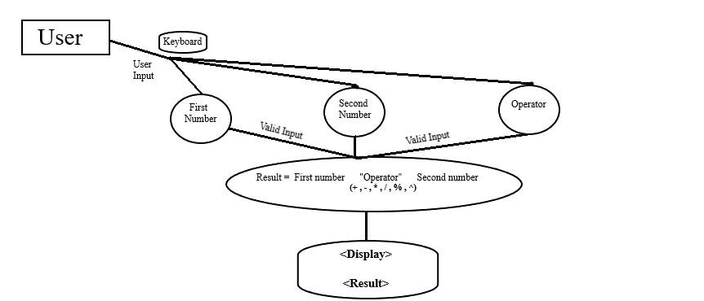
Block Diagram

Slide 7
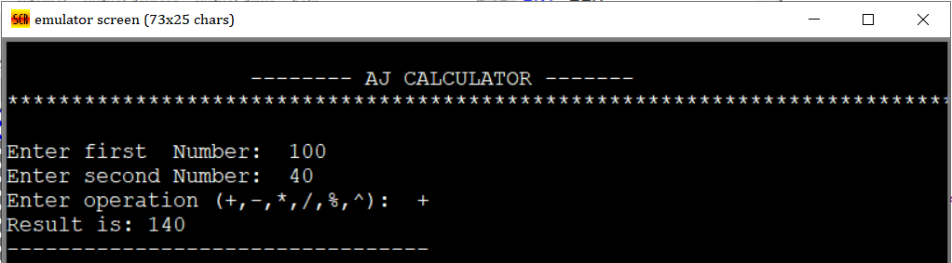
Operations (Addition)
MOV AX, CX
MOV DX, 00h
ADD AX, BX
ADC AX, DX
RET

Slide 8
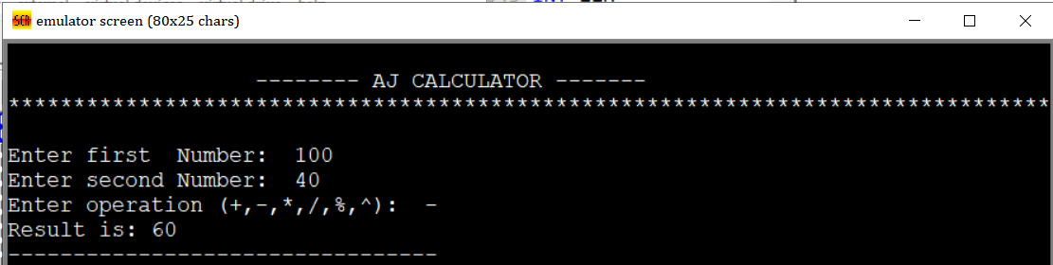
Operations (Subtraction)
MOV AX,CX
SUB AX,BX
JC ov
JNC nov
ov: NEG AX
MOV [overflow],01h
RET
nov: RET

Slide 9
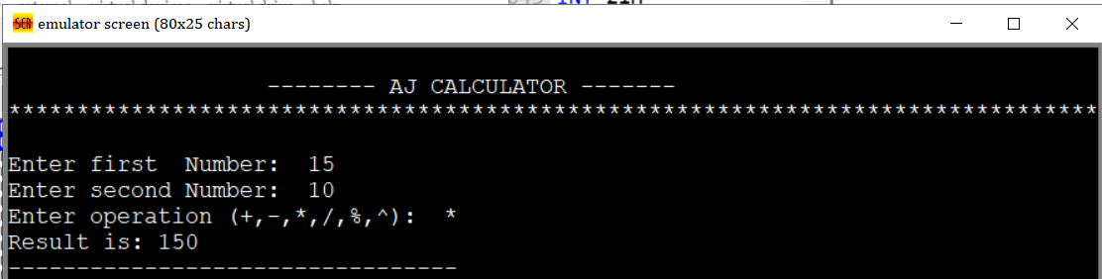
Operations (Multiplication)
MOV AX, CX
MUL BX
RET

Slide 10
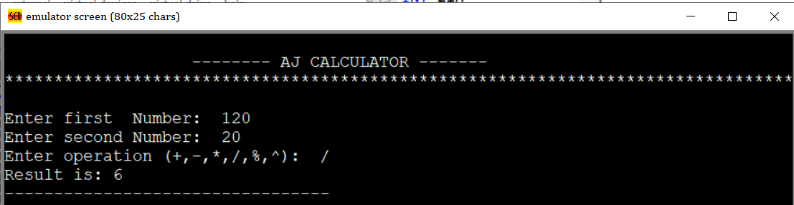
Operations (Division)
MOV AX,CX
MOV DX,00H
ADD BX,DX
JZ DbyZ
DIV BX
RET
DbyZ: print ' ERROR : DIVIDE BY ZERO'
JMP calculator

Slide 11
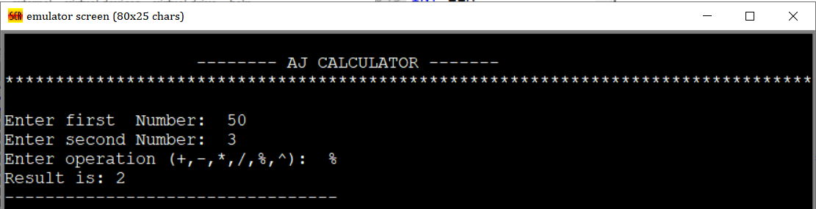
Operations (Modulues)
MOV AX,CX
MOV DX,00H
ADD BX,DX
JZ DbZ
DIV BX
MOV AX,DX
DbZ: RET

Slide 12
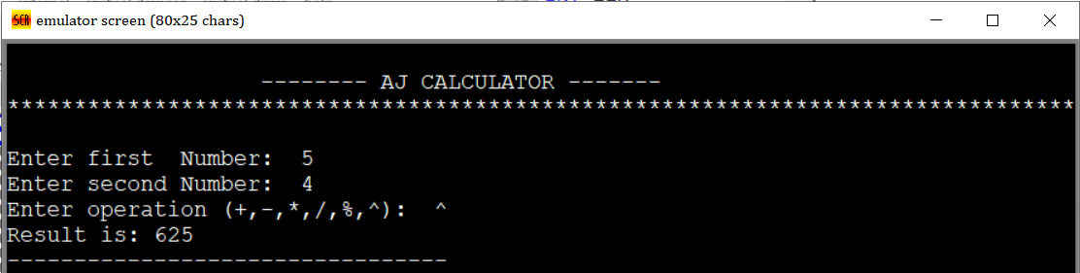
Operations (Power)
MOV AX,CX
MOV CX,BX
ADD CX,00h
JZ Lc
SUB CX,01h
JZ La
JNZ Lb
La: ret
Lb: MOV BX,AX
MOV DX,00h
L1: MUL BX
LOOP L1
ret
Lc: MOV AX,01h
ret

Slide 13
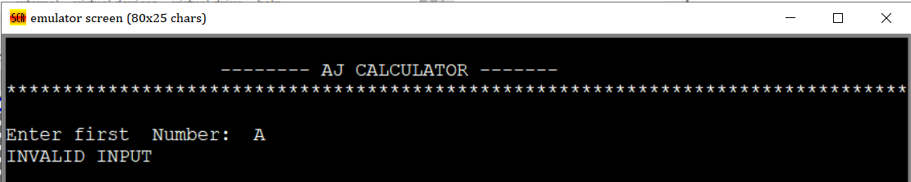
Operations (Invalid Input)
LEA DX, invalid_message
MOV AH, 09H
INT 21H
hlt

Slide 14
Conclusion
The project has been successfully completed by having established the user friendly interface with the help of Emu8086.It allows user to perform basic arithmetic operations on 16-bit decimal number.
It can be possible to make it more user friendly by adding more variety of functions to it and also by increasing its range (Ex. 32-bit ,64-bit etc).

Slide 15
Thank You…

